Slide 1
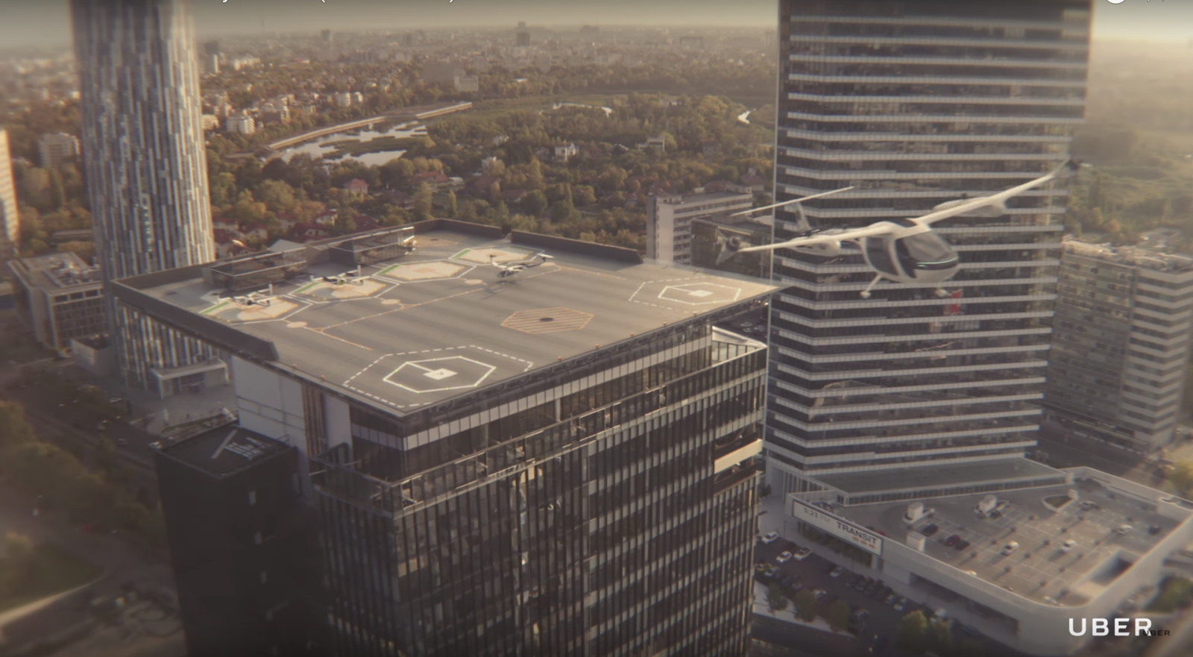
Elevate
Elevate – Closer than you think
Mark Moore
Elevate Vehicle Systems Director
Aeromechanics Design for Transformative Vertical Flight, January 16th 2018

Slide 2


Slide 3


Slide 4
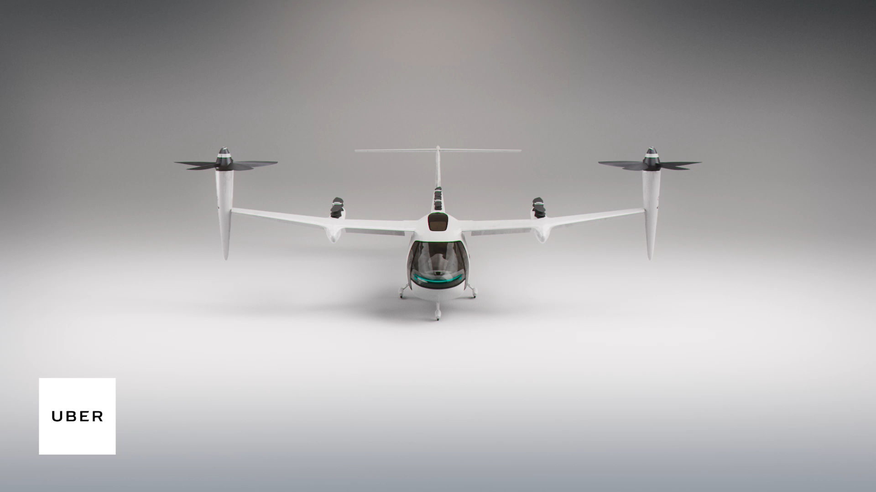

Slide 5



